Slide 1
Module 2:
Building Azure solutions using Azure Services
Notes:
Pictures and explanation has been adopted from Microsoft learn course and Microsoft website to help open-source community with free instructor led training

Slide 2
Module 2: Lesson 5:
Choose the best tools for managing and configuring your Azure environment

Slide 3
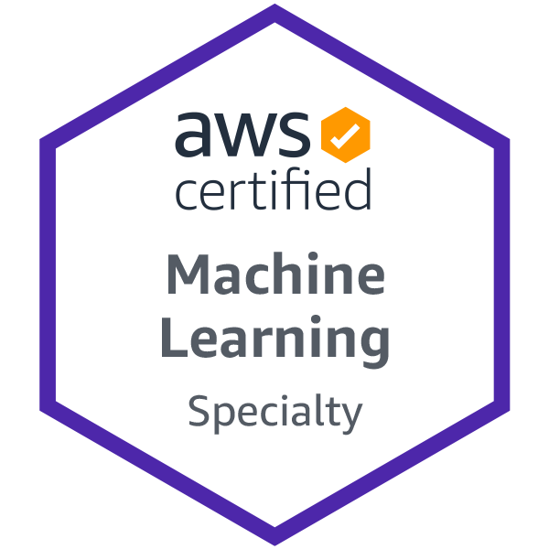





About The Presenter
Marwa Eshra
Senior Data Scientist
AWS ML Engineer certified
7+ years of experience in different industries
(medical, stock market, telecom & technology)
Help business Ops with data analysis, building ML models & visualizations
Email: Marwa_eshra@hotmail.com

Slide 4


Lesson 5: Overview
This lesson will cover
Introduction
Overview of cloud management tools
Decision Criteria Analysis
Apply decision criteria to help chose the best tool in different scenarios
Prepare for The Exam(Q/A)

Slide 5
Choose the best tools for managing and configuring your Azure environment
Introduction
Notes:
By using Azure management tools, administrators, developers, and managers can interact with the cloud environment to perform such tasks as:
Deploying dozens or hundreds of resources at a time.
Configuring individual services programmatically.
Viewing rich reports across usage, health, costs, and more.
Microsoft Azure provides a collection of management tooling options to choose from, depending on the situation.
Tailwind Traders, a traditional brick-and-mortar retailer, is now experiencing explosive growth by selling products online. The company owes much of its success to an ability to quickly and efficiently manage its cloud environment. As it began its cloud journey, Tailwind Traders initially had to choose the right management tools for its business needs.
In this module, you'll explore the array of Azure management tools and the decision criteria that experts use to select the right ones for their specific scenarios.

Slide 6
Overview
Management Tools
Management Tools Categories:
Visual Tools
Provide full, visually friendly access to all the functionality of Azure
Less useful when you're trying to set up a large deployment of resources with interdependencies and configuration options
Code-based tools
When you're attempting to quickly set up and configure Azure resources
Although it might take time to understand the right commands and parameters at first, after they've been entered, they can be saved into files and used repeatedly as needed.
The code that performs setup and configuration can be stored, versioned, and maintained along with application source code in a source code-management tool such as Git.
This approach to managing hardware and cloud resources, which developers use when they write application code, is referred to as infrastructure as code.
Visual
Tools
Code-based Tools
Notes:
At a high level, there are two broad categories of management tools: visual tools and code-based tools.

Slide 7
Overview
Management Tools
Management Tools Categories:
Visual Tools
Code-based tools
Infrastructure as Code:
Imperative Code
Details each step that should be performed to achieve a desired outcome
Declarative Code
Details only a desired outcome, and it allows an interpreter to decide how to best achieve that outcome
Provide a more robust approach to deploying dozens or hundreds of resources simultaneously and reliably
Visual
Tools
Code-based Tools
Imperative Code
Declarative Code

Slide 8
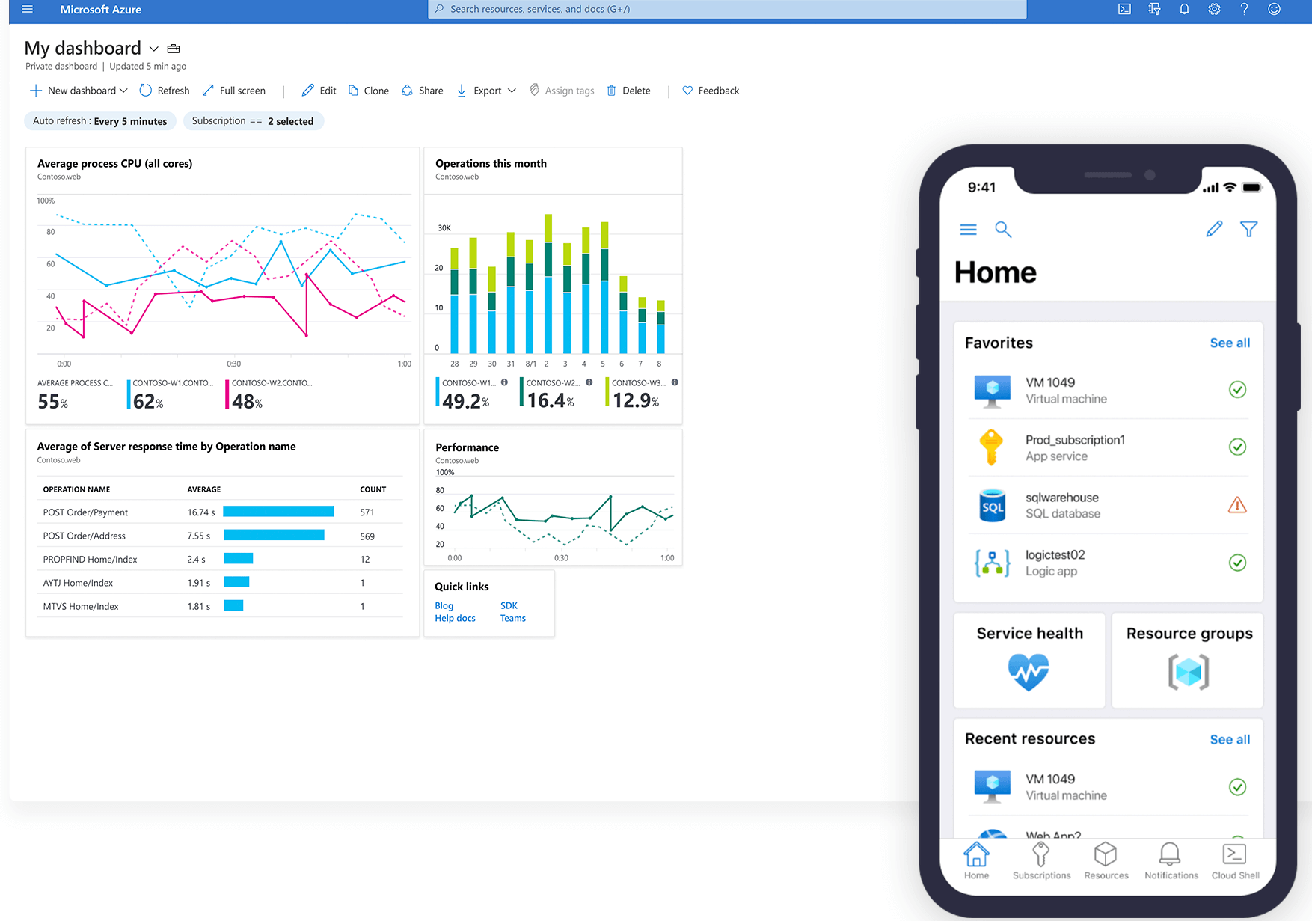
Product Options
Azure Portal
A web-based user interface, you can access virtually every feature of Azure.
Provides a friendly, graphical UI to view all the services you're using, create new services, configure your services, and view reports.
The Azure portal is how most users first experience Azure. But, as your Azure usage grows, you'll likely choose a more repeatable code-centric approach to managing your Azure resources.
Azure Mobile App
The Azure mobile app provides iOS and Android access to your Azure resources when you're away from your computer.
With it, you can:
Monitor the health and status of your Azure resources.
Check for alerts, quickly diagnose and fix issues, and restart a web app or virtual machine (VM).
Run the Azure CLI or Azure PowerShell commands to manage your Azure resources.
Notes:
Choose the Azure management tools that best address your organization's technical needs and challenges.

Slide 9
Product Options
3. Azure PowerShell
Azure PowerShell is a shell with which developers and DevOps and IT professionals can execute commands called cmdlets (pronounced command-lets). These commands call the Azure Rest API to perform every possible management task in Azure. Cmdlets can be executed independently or combined into a script file and executed together to orchestrate:
The routine setup, teardown, and maintenance of a single resource or multiple connected resources.
The deployment of an entire infrastructure, which might contain dozens or hundreds of resources, from imperative code.
Capturing the commands in a script makes the process repeatable and automatable.
Azure PowerShell is available for Windows, Linux, and Mac, and you can access it in a web browser via Azure Cloud Shell.
Windows PowerShell has helped Windows-centric IT organizations automate many of their on-premises operations for years, and these organizations have built up a large catalog of custom scripts and cmdlets, as well as expertise.

Slide 10
Product Options
4. Azure CLI
The Azure CLI command-line interface is an executable program with which a developer, DevOps professional, or IT professional can execute commands in Bash.
The commands call the Azure Rest API to perform every possible management task in Azure. You can run the commands independently or combined into a script and executed together for the routine setup, teardown, and maintenance of a single resource or an entire environment.
In many respects, the Azure CLI is almost identical to Azure PowerShell in what you can do with it. Both run on Windows, Linux, and Mac, and can be accessed in a web browser via Cloud Shell. The primary difference is the syntax you use. If you're already proficient in PowerShell or Bash, you can use the tool you prefer.

Slide 11
Product Options
5. ARM templates
Although it's possible to write imperative code in Azure PowerShell or the Azure CLI to set up and tear down one Azure resource or orchestrate an infrastructure comprising hundreds of resources, there's a better way to implement this functionality.
By using Azure Resource Manager templates (ARM templates), you can describe the resources you want to use in a declarative JSON format. The benefit is that the entire ARM template is verified before any code is executed to ensure that the resources will be created and connected correctly. The template then orchestrates the creation of those resources in parallel. That is, if you need 50 instances of the same resource, all 50 instances are created at the same time.
Ultimately, the developer, DevOps professional, or IT professional needs only to define the desired state and configuration of each resource in the ARM template, and the template does the rest. Templates can even execute PowerShell and Bash scripts before or after the resource has been set up.

Slide 12
Choose the best tools for managing and configuring your Azure environment
3 Decision Criteria

Slide 13
Decision Criteria
Need to perform one-off management, administrative, or reporting actions?
Azure PowerShell and the Azure CLI
Allow to quickly obtain the IP address of a virtual machine (VM) you've deployed, reboot a VM, or scale an app.
You might want to keep custom scripts for both tools handy on your local hard drive for certain operations that you need to perform multiple times.
If you're in a cloud management or administrative role, it's less efficient to rely solely on visual scanning and clicking. To quickly find the settings and information you want to work with, they will give you the most flexibility for repeatable tasks.
Azure Resource Manager templates (ARM templates)
Define the infrastructure requirements in your application for repeatable deployments.
Although ARM templates aren't intended for one-off scenarios, it's possible to use them for this purpose.
Azure portal
Can perform most, if not all, management and administrative actions.
If you're just learning Azure and/or need to set up and manage resources infrequently (or prefer a visual interface for viewing reports), it makes sense to take advantage of the visual presentation that the Azure portal offers.
Azure mobile app
Can access via an iOS or Android phone or tablet. Because it's full featured, it's likely the best choice when a laptop isn't readily available and you need to view and triage issues immediately.
Notes:
Do you need to perform one-off management, administrative, or reporting actions?
Azure PowerShell and the Azure CLI are Azure management tools that allow you to quickly obtain the IP address of a virtual machine (VM) you've deployed, reboot a VM, or scale an app. You might want to keep custom scripts for both tools handy on your local hard drive for certain operations that you need to perform multiple times.
By contrast to the Azure CLI and PowerShell, Azure Resource Manager templates (ARM templates) define the infrastructure requirements in your application for repeatable deployments. Although ARM templates aren't intended for one-off scenarios, it's possible to use them for this purpose. However, for one-off scenarios, you may prefer more agile tools like PowerShell, Azure CLI scripts, or the Azure portal.
Keep in mind that ARM templates can include both PowerShell and/or Azure CLI scripts, which will give you the ability to utilize scripts for tasks that may not be possible with the ARM template itself. The ability to combine Azure management tools gives flexibility in choosing the right tool(s) for your particular need.
The Azure portal can perform most, if not all, management and administrative actions. If you're just learning Azure and/or need to set up and manage resources infrequently (or prefer a visual interface for viewing reports), it makes sense to take advantage of the visual presentation that the Azure portal offers.
However, if you're in a cloud management or administrative role, it's less efficient to rely solely on visual scanning and clicking. To quickly find the settings and information you want to work with, the Azure CLI or PowerShell will give you the most flexibility for repeatable tasks.
The last management tool to discuss is the Azure mobile app, which you can access via an iOS or Android phone or tablet. Because it's full featured, it's likely the best choice when a laptop isn't readily available, and you need to view and triage issues immediately.

Slide 14
Decision Criteria
2. Need a repeatable and reliable way to set up one or more resources and ensure that all the dependencies are created in the proper order?
ARM templates
Validation step ensures that all resources can be created in the proper order based on dependencies, in parallel
PowerShell or CLI
Possible but not preferred to set up all development resources. As there’s no validation steps in these tools, if script encounters an error, dependency resources can’t be rolled back.
3. Need to write a script by using imperative code?
According to the administrator's background & preference:
Linux -> Azure CLI
Windows -> PowerShell
Notes:
Do you need a way to repeatedly set up one or more resources and ensure that all the dependencies are created in the proper order?
ARM templates define your application's infrastructure requirements for a repeatable deployment that is done in a consistent manner. A validation step ensures that all resources can be created in the proper order based on dependencies, in parallel, and idempotent.
By contrast, it's entirely possible to use either PowerShell or the Azure CLI to set up all the resources for a deployment. However, there's no validation step in these tools. If a script encounters an error, the dependency resources can't be rolled back easily, deployments happen serially, and only some operations are idempotent.
When you're scripting, do you come from a Windows administration or Linux administration background?
If you or your cloud administrators come from a Windows administration background, it's likely you'll prefer PowerShell. If you or your cloud administrators come from a Linux administration background, it's likely you'll prefer the Azure CLI. In practice, either tool can be used to perform most one-off administration tasks.

Slide 15
Choose the best tools for managing and configuring your Azure environment
Applying decision criteria to help chose the best tool in specific scenarios

Slide 16



Scenario 1
Tailwind Traders uses Azure extensively throughout its entire organization. To make sure that both the technical and executive teams are aware of the company's cloud spend, the director of cloud operations will begin to meet weekly with the chief financial officer (CFO) to talk about their cloud spend.
Conversations might begin at a high level, but the two officers might want to dive deep during the meeting to gain more insight into how Azure resources are being used. Ideally, they would be able to see the data displayed visually, but also be able to run custom reports in real time.
Which tool can they use during their meeting?
Need to perform one-off management, administrative, or reporting actions?
Azure Portal
Need a repeatable and reliable way to deploy the entire infrastructure?
Need to write a script by using imperative code?
Notes:
Use the Azure portal to visually understand and manage your cloud environment
Which service should you choose?
Apply the decision criteria you learned about in the preceding unit to find the right option.
First, in this scenario, does Tailwind Traders need to perform one-off management, administrative, or reporting actions? Yes, and given the requirement to view data visually and create custom reports during the meeting, the Azure portal is the best choice. The meeting attendees can quickly find answers to their questions by using a wealth of reporting options.
The next two decision criteria don't apply to this scenario, because the director of cloud operations and the CFO won't be deploying or configuring any resources.
The Azure portal is the correct product option for this scenario.

Slide 17
Scenario 2
Tailwind Traders employs technologists with many different skills. A team of developers and administrators builds and maintains a collection of intranet applications that are vital to the business. The team members have strong backgrounds in Windows development and network administration.
The team moved its applications to the cloud, and it now needs a way to perform one-off testing, management, and administrative tasks in its intranet environment. The team quickly realized that managing Azure from the portal takes too much time and is not repeatable.
Which tool should the company use for one-off tasks?
Need to perform one-off management, administrative, or reporting actions?
Need a repeatable and reliable way to deploy the entire infrastructure?
Need to write a script by using imperative code?
Windows -> Azure PowerShell
Notes:
Use Azure PowerShell for one-off administrative tasks
Which service should you choose?
As you did in the preceding unit, apply the decision criteria you learned about earlier to find the right option.
First, in this scenario, does the Tailwind Traders team need to perform one-off management, administrative, or reporting tasks? Yes. However, the team already knows that it doesn't want to rely on the Azure portal for these one-off actions. Therefore, both Azure PowerShell and the Azure CLI are good options. We'll hone in on which tool the team should use in a moment.
Second, in this scenario, does Tailwind Traders need a repeatable and reliable means of deploying its entire infrastructure? No, not in this scenario. Therefore, Azure Resource Manager templates (ARM templates) are not the right choice.
When the Tailwind Traders team is doing scripting, does it come from a Windows administration or Linux administration background? This team has a Windows administration background. It would likely be most comfortable using Azure PowerShell, because this tool allows it to use the syntax it's most comfortable with to perform one-off administration tasks.
Azure PowerShell is the best choice for this scenario.

Slide 18
Scenario 3
As we noted in the preceding unit, Tailwind Traders employs technologists with many different skills. The DevOps team is primarily concerned with keeping external systems, such as the company's e-commerce site, up and running.
This team has a Linux administration background. It frequently needs to perform administrative tasks related to the health of the cloud environment. The team quickly realized that managing Azure from the portal takes too much time and isn't repeatable.
Which tool should it use for one-off tasks?
Need to perform one-off management, administrative, or reporting actions?
Need a repeatable and reliable way to deploy the entire infrastructure?
Need to write a script by using imperative code?
Linux -> Azure CLI
Notes:
Use the Azure CLI for one-off administrative tasks
Which service should you choose?
Once again, apply the decision criteria you learned about earlier to find the right option.
Because this scenario is almost identical to the one in the preceding unit, you can skip over the first two criteria. In other words, you can quickly eliminate Azure Resource Manager templates (ARM templates) and the Azure portal as viable options for this scenario. So, let's go to the third decision criterion.
Choosing the right option in this scenario should be determined by the team's background. Because this team has a Linux administration background, it would likely be most comfortable using the Azure CLI. The Azure CLI allows the team to use the Bash shell and its syntax to perform one-off administration tasks.
The Azure CLI is the best choice for this scenario.

Slide 19
Scenario 4
Tailwind Traders experiences surges in e-commerce traffic that coincide with national holidays and weekends. In the company's first few years, managers of critical systems had to convene at the office of the director of cloud operations during these important periods.
However, now that Tailwind Traders has successfully operationalized most critical systems, the director wants to relax this requirement and allow employees to spend these dates with their families.
Is there a product that can help support this scenario?
Need to perform one-off management, administrative, or reporting actions?
Azure Mobile App
Need a repeatable and reliable way to deploy the entire infrastructure?
Need to write a script by using imperative code?
Notes:
Use the Azure mobile app to manage Azure on the go
Which service should you choose?
Let's run through our decision criteria again.
First, does Tailwind Traders need to perform one-off management, administrative, reporting actions? Yes. The real question is, how? A phone or tablet solution could help key employees keep an eye on the health of the cloud environment when they're out of the office. The Azure mobile app is likely a good compromise, because it lets employees be away from work and still perform essential, one-off management and administrative tasks.
We can skip the rest of the decision criteria in this unique scenario. The Azure mobile app is the right choice.

Slide 20
Scenario 5
Tailwind Traders wants to operationalize their cloud deployments. The company needs a repeatable, reliable way to scale its operations during peak sales periods. Because you'll be choosing a process for scaling your production environment, you need to ensure that your chosen service:
Is efficient and can potentially create many resources in parallel.
Creates all dependencies in the correct order.
Can be used without worrying that it failed in the middle of provisioning the necessary infrastructure.
Need to perform one-off management, administrative, or reporting actions?
Need a repeatable and reliable way to deploy the entire infrastructure?
ARM templates
Need to write a script by using imperative code?
Notes:
Use ARM templates to deploy an entire cloud infrastructure
Which service should you choose?
Let's run through the decision criteria one more time.
First, in this scenario, does Tailwind Traders need to perform one-off management, administrative, or reporting actions? This time, we're not looking to support one-time or one-off management or administration tasks. We're looking for a technology to automate the deployment of an entire infrastructure, as needed.
Second, does Tailwind Traders need a repeatable and reliable way to deploy its entire infrastructure? Yes, this is exactly what the company needs. Our decision criteria lead us to choose Azure Resource Manager templates (ARM templates) for this scenario.
You could use Azure PowerShell or the Azure CLI, but these scripting technologies have significant limitations when it comes to deploying infrastructure. ARM templates can help overcome these limitations.
The third decision criterion assumes that you need to write a script by using imperative code. However, when you use ARM templates, you define your infrastructure declaratively by using JSON code. In some instances, you still might need imperative code for configuration or clean-up tasks. In these cases, you can trigger the execution of scripts by using either Azure PowerShell or the Azure CLI to perform these tasks.
In this scenario, ARM templates are the correct choice.

Slide 21


Prepare for The Exam (Q/A)
1. As an administrator, you need to retrieve the IP address from a particular VM by using Bash. Which of the following tools should you use?
ARM templates
Azure PowerShell
Azure Portal
Azure CLI
Notes:
The Azure CLI enables you to use Bash to run one-off tasks on Azure.

Slide 22
Prepare for The Exam (Q/A)
3. You're a developer who needs to set up your first VM to host a process that runs nightly. Which of the following tools is your best choice?
ARM templates
Azure PowerShell
Azure Portal
Azure CLI
Notes:
The Azure portal is a great place for newcomers to learn about Azure and set up their first resources.

Slide 23
Prepare for The Exam (Q/A)
3. What is the best infrastructure-as-code option for quickly and reliably setting up your entire cloud infrastructure declaratively?
ARM templates
Azure PowerShell
Azure Portal
Azure CLI
Notes:
ARM templates are the best infrastructure-as-code option for quickly and reliably setting up your entire cloud infrastructure declaratively.

Slide 24

Summary
This lesson has covered
Overview of cloud management tools
Azure Portal
Azure Mobile App
Azure PowerShell
Azure CLI
Azure Resource Management (ARM) Templates
Applied decision criteria to help chose the best tool in specific scenarios
Decision criteria Analysis
Use the Azure portal to visually understand and manage your cloud environment
Use Azure PowerShell for one-off administrative tasks
Use the Azure CLI for one-off administrative tasks
Use the Azure mobile app to manage Azure on the go
Use ARM templates to deploy an entire cloud infrastructure

Slide 25
Summary
Next Lesson:
-> M2-L6

